Slide 1
Using the Education and Career Plan to Help Your Students Achieve Their Dreams
Stacie Fehrm, M.Ed.
The Literacy Program of Greater Plymouth

Slide 2
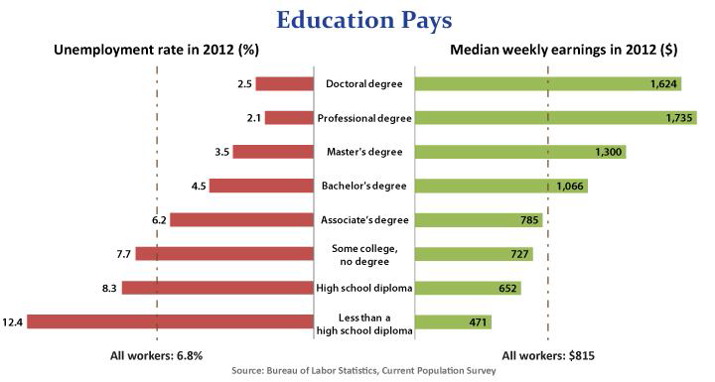
Education Pays
Our students know this. They come to our door seeking our help.
We have a captive audience of people seeking to improve their lives. We are obligated to help them.
Education pays ...in higher earnings and lower unemployment rates

Slide 3
You are not alone!
Get excited about your future.
There is something for everyone.
HiSET opens all doors.
6.5M adults in Massachusetts.
700,000 do not have a high school credential.
1 out of 7 with high school credential in the U.S. have a GED.
Attendance is the #1 predictor of success.
We are here to help you.

Slide 4
Orientation:
DESE Educational and Career Plan
What prompted you to pursue further education now?
What are your career/educational goals?
What do you need to do accomplish these?
Where do you see yourself in 5 years?

Slide 5
Educational and Career Planning
Self Assessment
-Interests
-Skills/Abilities
-Work Values
Career Research
-Internet
-Labor statistics
-Informational
Interviews
Educational Planning
-FAFSA
-College websites
-College tours
-Guest speakers
-Career Center
Job Seeking Skills
-Work Ethic
-Networking
-Resumes
-Cover letters
-Interviewing
-Thank you letters
-References

Slide 6
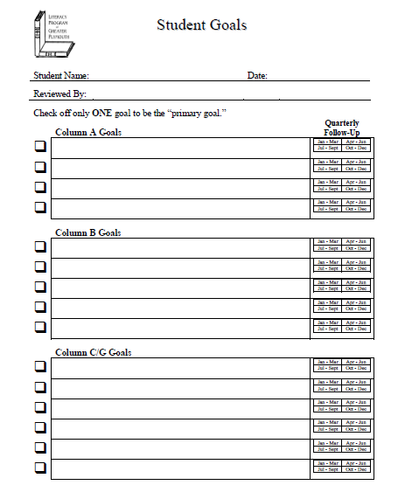
Individual Goal Setting

Slide 7
Short term goals
What are you doing now?
Focus habits
Characteristics of Successful Students

Slide 8
Self-Assessment
Understand who you are and what you have to offer the job market.
Interests
Harrington-O’Shea Career Assessment
The Holland Code
Skills and Abilities
Unlocking Potential for Adults with Learning Differences-Multiple Intelligence
Integrating Career Awareness in the ABE Classroom-
Skills Identification
Work Values
Values Elimination

Slide 9
Career Research
What kind of job matches who you are?
Capitalize on strengths!
O-Net.org
Occupational Outlook Handbook.gov
Mass CIS
Informational Interviews
Labor Statistics

Slide 10
Educational Planning
FAFSA
College Websites
College Tours
Accuplacer
Guest Speakers
Career Centers/Workforce Development

Slide 11
Job Seeking Skills
Land that job!
Top 10 traits valued by employers:
Strong Work Ethic
Dependability & Responsibility
Positive attitude
Adaptability
Honesty and Integrity
Self-Motivation
Self-confidence
Professionalism
Loyalty
Desire to Learn

Slide 12
Networking and finding job openings
True or False
(adapted from What Color is Your Parachute?)
1. There are few jobs “out there” when the economy is slow.
2. If you can’t find job openings, that proves there are none.
3. Most people know what to do when it comes to looking for a job.
4. The person who is hired can do the job the best.

Slide 13
True or False (adapted from What Color is Your Parachute?)
I. There are few jobs “out there” when the economy is slow.
A. Job openings are constantly churning. Musical chairs.
II. If you can’t find job openings, that proves there are none.
A. 4/5 people get jobs from people they know.
B. 1.1 million jobs open every year in Massachusetts. 300K new, 800K replacement.
C. We need to prepare our students for the 21st century. Skills Gap.
III. Most people know what to do when it comes to looking for a job.
A.75-80% of job openings are not advertised.
B. Need to tap into hidden job market.
C. Use as many different methods as possible. Spend the most time on the methods that work:
  Referrals
  Direct contact
  Agencies
  Ads
  Face to face is still best
  Work on interview techniques
  Take any job to get a foot in the door
  Know what you have to offer
IV. The person who is hired can do the job the best.
A. It’s the person who knows how to get hired.
B. If you’re qualified, now what?

Slide 14
Job Seekers look for jobs
Internet
Newspaper
Employers
Agencies
Friends
Employers look for employees
Internet
Newspaper Ads
Within
Agencies
Referrals/Direct Contact

Slide 15
Put your best foot forward
Cover letters
Resumes
Interviewing
References
Thank you letters

