Slide 1

David J. Rosen, Ed.D. , Newsome Associates
April 4, 2014 MCAE Network 2014
Key Findings from the Program for the International Assessment of Adult Competencies (PIAAC), 2012
Slides developed by Sondra Stein,
Katie Landeros,& Tim Werwath
American Institutes for Research
Notes:
Hello and welcome. Today, I’ll be presenting highlight results from the 2012 Program for the International Assessment of Adult Competencies (PIAAC).

Slide 2
What is PIAAC?
  International large-scale assessment administered in 2011-12 in 23 countries
  16- to 65-year-olds, non-institutionalized, residing in the country, irrespective of nationality, citizenship, or language status
  Laptop computer or paper-and-pencil:
    In the U.S., 80% took the computer tests and 15% took the paper-and-pencil tests.
  Assessment subjects:
    Literacy, Numeracy, and Problem Solving in Technology-Rich Environments
  Conducted in English in the U.S.:
    Background survey in English or Spanish. About 4% could not complete the questionnaire because of language difficulties or learning or mental disabilities, and 1% could not complete it for other reasons.

Slide 3
Participating Countries
2012 |  | 2015
Australia Austria Belgium Canada Cyprus Czech Republic Denmark Estonia Finland France Germany Ireland | Italy Japan Korea, Rep of Netherlands Norway Poland Slovak Republic Spain Sweden United Kingdom United States | Chile Greece Indonesia Israel Lithuania New Zealand Singapore Slovenia Turkey

Slide 4
How did the U.S. do on PIAAC?
https://www.youtube.com/watch?v=UgRwgFD-Ynk

Slide 5
General patterns of U.S. results
Below international average in all subject areas
Ranked better in literacy than in numeracy or problem solving in technology-rich environments
Higher percentage at low proficiency levels than international average
Percentages of top performers similar to or slightly lower than international average, depending on the subject

Slide 6
Definitions:
Literacy:
“understanding, evaluating, using and engaging with written text to participate in society, to achieve one’s goals and to develop one’s knowledge and potential.”
Numeracy:
“the ability to access, use, interpret, and communicate mathematical information and ideas, to engage in and manage mathematical demands of a range of situations in adult life.”

Slide 7
Definitions
Problem solving in technology rich environments (PS-TRE):
“using digital technology, communication tools, and networks to acquire and evaluate information, communicate with others, and perform practical tasks.”
Reading components:
“measuring literacy skills of adults at the lower end of the literacy spectrum, focusing on reading components that are comparable across the range of languages (reading vocabulary, sentence comprehension, and basic passage comprehension and fluency).”

Slide 8
What PIAAC Reports
Average Scores: Reported on a scale of 0-500 for all domains.
Proficiency Levels: Reported as the percentages of adults scoring at six performance levels in literacy and
numeracy and at four performance levels in problem solving in technology-rich environments.
Notes:
Scale scores are set based on the likelihood of people providing correct responses on items of increasing difficulty.
Levels are set based on the scale scores cut to reflect the mastery of the tasks required to achieve that level.

Slide 9
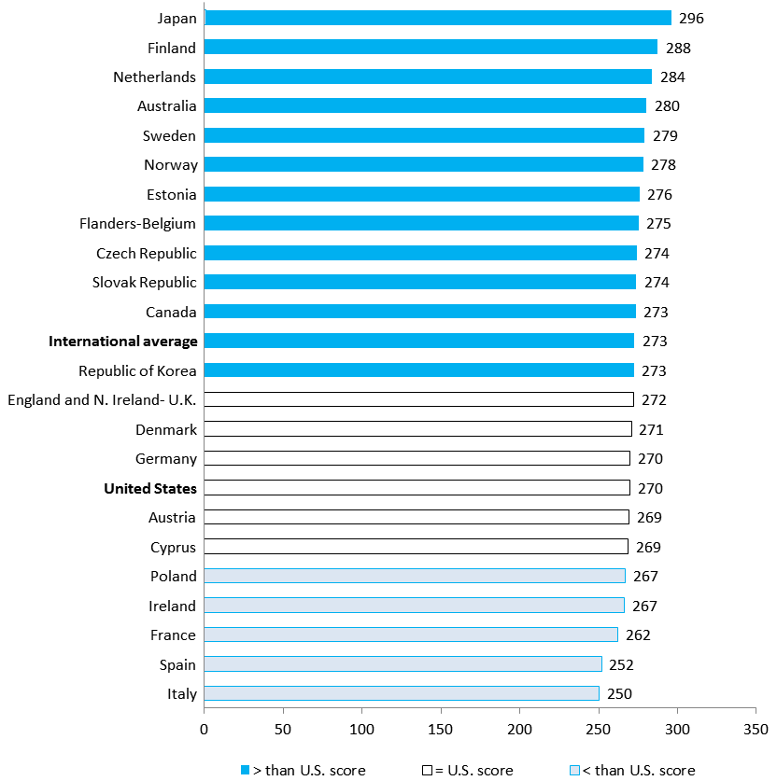
U.S. average literacy score (270) lower than the international average (273)
Lower than in 12 countries:
Japan, Finland, Netherlands, Australia, Sweden, Norway, Estonia, Flanders-Belgium, Czech Republic, Slovak Republic, Canada, Republic of Korea
Not significantly different than in 5 countries:
England and Northern Ireland- U.K., Denmark, Germany, Austria, Cyprus
Higher than in 5 countries:
Poland, Ireland, France, Spain, Italy

Slide 10
Literacy proficiency levels
Locate single piece of information in familiar texts.
Read relatively short digital, print or mixed texts to locate single text.
Identify, interpret, or evaluate one or more pieces of information and often require varying levels of inference.
Make matches between text and information that may require low level para-phrasing and drawing low-level inferences.
Perform multiple-step operations to integrate, interpret, or synthesize information from complex texts, and may require complex inferences.
Integrate information across multiple, dense texts; construct syntheses, ideas or points of view; or evaluate evidence based arguments.
Level 5
Level 4
Level 3
Level 2
Below Level 1
Level 1
Notes:
Look at these levels carefully: in US, our average is near the top of level 2 – half of our adult working age population can make matches…but they are not likely to be able to…skills that are required not just for good jobs that can support a family but for many tasks that are critical to family health and well-being.
Below Level 1: Individuals at this level can read brief texts on familiar topics and locate a single piece of specific information identical in form to information in the question or directive. They are not required to understand the structure of sentences or paragraphs and only basic vocabulary knowledge is required. Tasks below Level 1 do not make use of any features specific to digital texts.
Level 1: Individuals at this level can read relatively short digital or print continuous, non-continuous, or mixed texts to locate a single piece of information, which is identical to or synonymous with the information given in the question or directive. These texts contain little competing information. Adults performing at this level can complete single forms, understand basic vocabulary, determine the meaning of sentences, and read continuous texts with a degree of fluency.
Level 2: Individuals at this level can integrate two or more pieces of information based on criteria, compare and contrast or reason about information and make low-level inferences. They can navigate within digital texts to access and identify information from various parts of a document.
Level 3: Individuals at this level can understand and respond appropriately to dense or lengthy texts, including continuous, non-continuous, mixed, or multiple pages. They understand text structures and rhetorical devices and can identify, interpret, or evaluate one or more pieces of information and make appropriate inferences. They can also perform multi-step operations and select relevant data from competing information in order to identify and formulate responses.
Level 4: Individuals at this level can perform multiple-step operations to integrate, interpret, or synthesize information from complex or lengthy continuous, non-continuous, mixed, or multiple-type texts that involve conditional and/or competing information. They can make complex inferences and appropriately apply background knowledge as well as interpret or evaluate subtle truth claims or arguments.
Level 5: Individuals at this level can perform tasks that involve searching for and integrating information across multiple, dense texts; constructing synthesis of similar and contrasting ideas or points of view, or evaluating evidence and arguments. They can apply and evaluate logical and conceptual models, and evaluate the reliability of evidentiary sources and select key information. They are aware of subtle, rhetorical cues and are able to make high-level inferences or use specialized background knowledge.

Slide 11
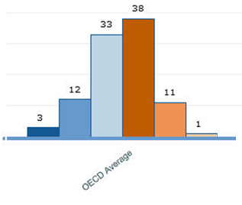
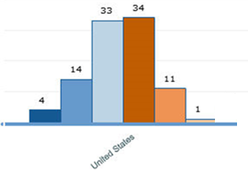

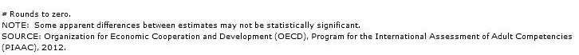
Distribution of literacy skills
Notes:
In the U.S., 51% of adults performed at level 2 or below in literacy.
33% at Level 2, 14% at Level 1, and 4% Below Level 1

Slide 12
Least educated adults below the international average in literacy
*p < .05. U.S. average score is significantly different from PIAAC international average.
Notes:
Educational attainment has a strong positive relationship to proficiency. Adults with tertiary-level qualifications have a 36 score-point (equivalent of around five years of additional education) advantage on the literacy scale, on average, over adults who have not attained upper secondary education, after other characteristics have been taken into account.

Slide 13
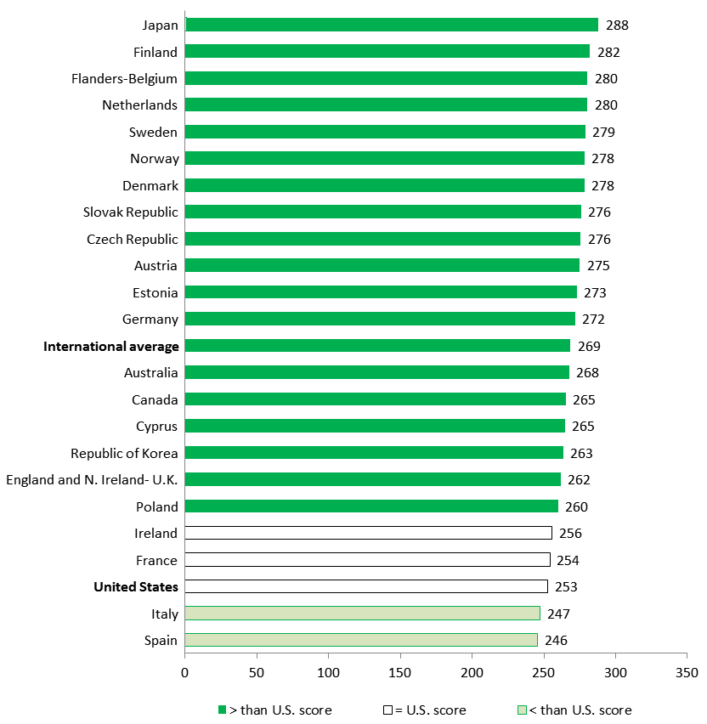
U.S. average numeracy score (253) lower than the international average (269)
Lower than in 18 countries:
Japan, Finland, Flanders-Belgium, Netherlands, Sweden, Norway, Denmark, Slovak Republic, Czech Republic, Austria, Estonia, Germany, Australia, Canada, Cyprus, Republic of Korea, England and Northern Ireland- U.K., Poland
Not significantly different
than in 2 countries:
Ireland, France
Higher than in 2 countries:
Italy, Spain

Slide 14
Numeracy proficiency levels
Level 5
Perform basic tasks: counting, arithmetic operations with whole numbers.
Perform one-step tasks: count; sort; arithmetic operations; understanding simple percent (ex. 50%).
Perform 2 or more calculations, simple measurement; spatial representation; estimation; and interpret simple tables, graphs.
Understand & work with mathematical patterns, proportions, basic statistics expressed in verbal or numerical form.
Understand complex abstract mathema-tical and statistical ideas, embedded in complex texts, draw inferences; arguments or models; justify, reflect on solutions or choices.
Perform analysis, complex reasoning, statistics and chance; spatial relationships; and communicat-ing well-reasoned explanations for answers.
Level 4
Level 3
Level 2
Level 1
Below Level 1
Notes:
Again – let’s look at levels. This time our average is solidly in the middle of level 2…
Below Level 1: Adults at this level can only cope with very simple tasks set in concrete, familiar contexts where the mathematical content
is explicit and that require only simple processes such as counting; sorting; performing basic arithmetic operations with
whole numbers or money, or recognizing common spatial representations. Adults who score less than 176 points are
considered to be below Level 1.
Level 1: Adults at Level 1 can complete tasks involving basic mathematical processes in common, concrete contexts where the
mathematical content is explicit with little text and minimal distractors. They can perform one-step or simple processes
involving counting, sorting, basic arithmetic operations, understanding simple percents, and locating and identifying
elements of simple or common graphical or spatial representations.
Level 2: Adults at this level can successfully perform tasks that require identifying and acting upon mathematical information and
ideas embedded in a range of common contexts where the mathematical content is fairly explicit or visual with relatively
few distractors. The tasks may require applying two or more steps or processes involving, for example, calculations
with whole numbers and common decimals, percents and fractions; simple measurement and spatial representations;
estimation; or interpreting relatively simple data and statistics in texts, tables and graphs.
Level 3: Adults at Level 3 can successfully complete tasks that require an understanding of mathematical information that may
be less explicit, embedded in contexts that are not always familiar, and represented in more complex ways. They can
perform tasks requiring several steps and that may involve a choice of problem-solving strategies and relevant processes.
They have a good sense of number and space; can recognize and work with mathematical relationships, patterns, and
proportions expressed in verbal or numerical form; and can interpret and perform basic analyses of data and statistics
in texts, tables and graphs.
Level 4: At this level, adults understand a broad range of mathematical information that may be complex, abstract or embedded
in unfamiliar contexts. They can perform tasks involving multiple steps and select appropriate problem-solving strategies
and processes. They can analyze and engage in more complex reasoning about quantities and data, statistics and chance,
spatial relationships, change, proportions and formulae. They can also understand arguments and communicate well-reasoned explanations for answers or choices.
Level 5: Adults at Level 5 on the numeracy scale can understand complex representations, and abstract and formal mathematical
and statistical ideas, sometimes embedded in complex texts. They can integrate several types of mathematical information
where considerable translation or interpretation is required; draw inferences; develop or work with mathematical
arguments or models; and justify, evaluate and critically reflect upon solutions or choices.

Slide 15
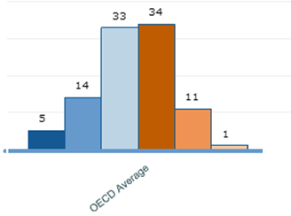
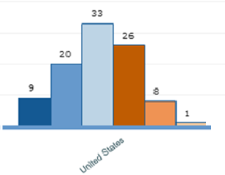

Distribution of numeracy skills
Notes:
In the U.S., 62% of adults performed at level 2 or below in numeracy.
33% at Level 2, 20% at Level 1, and 9% Below Level 1

Slide 16
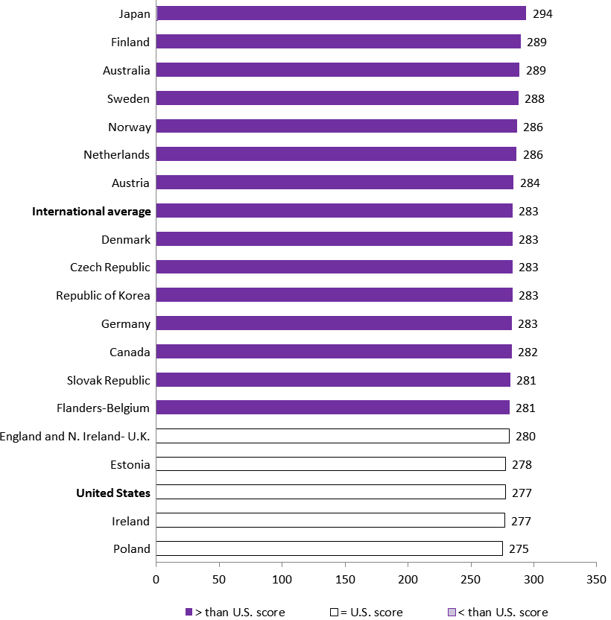
U.S. average problem solving in technology-rich environments score (277) lower than the international average (283)
Lower than in 14 countries:
Japan, Finland, Australia, Sweden, Norway, Netherlands, Austria, Denmark, Czech Republic, Republic of Korea,
Germany, Canada, Slovak Republic,
Flanders-Belgium
Not significantly different than in 4 countries:
England and Northern Ireland- U.K.,
Estonia, Ireland, Poland

Slide 17
Problem solving in technology-rich environments (digital problem solving) proficiency levels
Level 3
Tasks are well-defined involving use of only one function within a generic interface.
Tasks require little or no navigation, and only a few steps to access information for solving the problem. There are few monitoring demands.
Tasks require some navigation across pages and applications for solving the problem. Evaluating the relevance, some integration and inferential reasoning may be needed.
Task may involve multiple steps and operators, navigation across pages and applications. There are typically high monitoring demands, and evaluation of relevance and reliability of information.
Level 2
Level 1
Below Level 1
Notes:
Again, let’s look at these levels: Think about the tasks that you do everyday for work. Easily require level 2 skills. But average is at level 1.
Below Level 1: Below Level 1, adults can complete tasks in which the goal is explicitly stated and for which the necessary operations are performed in a single and familiar environment. They can solve problems whose solutions involve a relatively small number
of steps, the use of a restricted range of operators, and a limited amount of monitoring across a large number of actions.
Level 1: At Level 1, adults can complete tasks in which the goal is explicitly stated and for which the necessary operations are
performed in a single and familiar environment. They can solve problems in the context of technology-rich environments
whose solutions involve a relatively small number of steps, the use of a restricted range of operators, and a limited
amount of monitoring across a large number of actions.
Level 2: At Level 2, adults can complete problems that have explicit criteria for success, a small number of applications, and
several steps and operators. They can monitor progress towards a solution and handle unexpected outcomes or impasses.
Level 3: Adults at Level 3 can complete tasks involving multiple applications, a large number of steps, impasses, and the discovery
and use of ad hoc commands in a novel environment. They can establish a plan to arrive at a solution and monitor its
implementation as they deal with unexpected outcomes and impasses.

Slide 18
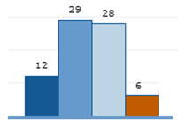
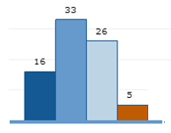




Distribution of digital problem solving skills in the U.S. and other countries
Notes:
In the U.S., 75% of adults performed at level 2 or below in PS-TRE.
26% at Level 2, 33% at Level 1, and 16% Below Level 1

Slide 19


Time for the U.S. to Reskill? What the Survey of Adult Skills Says (an OECD report)
Low “basic” (Below Level 1 and Level 1) skills are more common in U.S. than on average in participating countries
  Nearly 1 in 3 have weak numeracy skills in the U.S. compared to the international average of 1 in 5.
  About 1 in 6 adults in the U.S. have low literacy skills compared to 1 in 20 in Japan.
US:
International Average:
Notes:
Now we’d like to take a closer look at those who scored below level 2 on PIAAC.
How do we compare to the international average?
How do we compare to high performers like Japan and Finland?

Slide 20
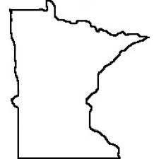
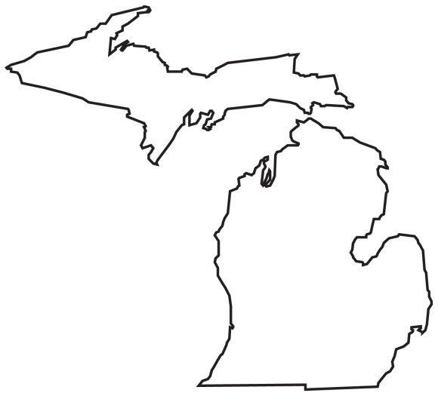
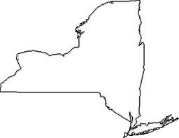
Time for the U.S. to Reskill? What the Survey of Adult Skills Says (an OECD report) continued
Approximately 36 million U.S. adults have low skills.
Roughly the same population of Minnesota, New York, and Michigan states combined.
+
NY
+
MN
MI

Slide 21
Adults in the U.S. at level 2
and below

Slide 22
Who are the low-skilled adults in the U.S. in literacy?
Educational attainment
Notes:
Although skill level is strongly correlated with educational attainment, you can see that even at the highest levels of attainment there are adults with low skills:
Among 10% w/ grad/prof degree, there was not enough data to report BL1, 2% at L1, 15% at L3
Among 16% w/ Bachelor’s, 1% BL1, 4% at L1, 22% at L2
Among 9% w/ Associate’s, 1% BL1, 6% at L1, 34% at L2
Among 50% w/ HS credential, 3% BL1, 17% at L1, 41% at L2
Among 15% below HS education, 15% BL1, 31% at L1, 37% at L2

Slide 23
Who are the low-skilled adults in the U.S. in literacy?
Age
Notes:
While there is some improvement in the youngest cohorts:
Still 51% are at level 2 or below…
Among 18% 16-24 yr-olds, 2% are BL1, 12% at L1, and 37% L2
Among 20% 25-34 yr-olds, 4% are BL1, 12% at L1, 30% at L2
Among 20% 35-44 yr-olds, 3% are BL1, 14% at L1, 31% L2
Among 22% 45-54 yr-olds, 6% are BL1, 14% at L1, 32% at L2
Among 19% 55-65 yr-olds, 5% are BL1, 16% at L1, 34% at L2

Slide 24
Who are the low-skilled adults in the U.S. in literacy?
First language
Notes:
If English is NOT your first language, you are much ore likely to score at the lowest levels.
72% of those for whom English is not the first language scored at level 2 or below in literacy.
Among 85% w/ English as first language, 2% are BL1, 12% at L1, 34% at L2
Among 15% w/ other as first language, 15% are BL1, 24% at L1, 33% at L2

Slide 25
Who are the low-skilled adults in the U.S. in literacy?
Immigration status
Notes:
And the percentages are similar for native born v immigrant.
While 48% of native born scored at level 2 and below
70% of immigrants score at level 2 and below.
Among 85% born in U.S., 2% BL1, 12% at L1, 34% at L2
Among 15% not born in U.S., 15% BL1, 25% at L1, 31% at L2

Slide 26
Who are the low-skilled adults in the U.S. in literacy?
Race/ethnicity
Notes:
Note: unlike the previous charts that show as percent of the total sample, this slide shows the race/ethnicity out of the people who took the assessment (from the First Look report)
Among 65% White, non-Hispanic 1% BL1, 9% at L1, 32% at L2 for a total of 42%
Among 13% Black, non-Hispanic 7% BL1, 28% at L1, 41% at L2 for a total of 76%
Among 14% Hispanic, 15% BL1, 28% at L1, 36% at L2 for a total of 79%
Among other 8% races, 3% BL1, 14% at L1, 35% at L2

Slide 27
Who are the low-skilled adults in the U.S. in literacy?
Gender
Notes:
As you can see,, there is not much difference by gender:
Among 49% men, 4% are BL1, 14% at L1, 31% at L2
Among 51% women, 4% are BL1, 13% at L1, 34% at L2

Slide 28
Who are the low-skilled adults in the U.S. in literacy?
Employment status
 | U.S. Pop. 16-65 = approx. 200 million |  |  | Percent of subpopulation
 |  |  | Percent of population | Below Level 1 | Level 1 | Level 2
All U.S. 16-65 |  |  | 100 | 4 | 14 | 33
Employment status
 | Employed full-time |  | 52 | 4 | 12 | 31
 | Employed part-time |  | 12 | 4 | 15 | 36
 | Unemployed |  | 8 | 5 | 24 | 41
 | In school |  | 10 | 2 | 10 | 35
 | Retired |  | 4 | 3 | 16 | 36
 | Permanently disabled |  | 5 | 14 | 29 | 40
 | Looking after family |  | 6 | 3 | 14 | 38
 | Other |  | 3 | 5 | 12 | 35
Notes:
This chart shows the relationship between employment and skill level
Although 52% of the low skilled are employed full time
You can see that a higher percentage of those who are employed only art time or who are unemployed have lower skills
So that while the skill levels of those who are employed full time is pretty much the same as those of the overall population,
A higher percentage of those who are employed part time (55%) scored at level 2 or below
And 70% of those who are unemployed scored at level 2 or below.

Slide 29
Who are the low-skilled adults in the U.S. in literacy?
Industry
Notes:
This slide shows us which industries have the highest proportions of those who scored at level 2 or below
The highest percentage of low-skilled are in: construction, administration transportation, and accommodation and food services.
Ranked by total percentage in Level 2 + Level 1 + BL1
*ranking is based on the unrounded estimates

Slide 30
Who are the low-skilled adults in the U.S. in literacy?
Occupation
Notes:
Now if we look at the kinds of occupations, we see that there are a higher proportion of low killed workers in occupations requiring the least skills
What we call manual labor and semiskilled blue and white collar labor
Ranked by total percentage in Level 2 + Level 1 + BL1
*ranking is based on the unrounded estimates

Slide 31
Comparing Gaps in Performance
Notes:
So that gives you a little richer picture of who the low-skilled adults in the US are: many of you know them, of course, from your programs.
And these statistics are confirmation rather than new information..
However, they give us a sense of where the problems are greatest in our communities, and who are our natural allies in building literacy.
Now I’d like to turn to a few slides that focus on the gaps in literacy in the US as compared to other countries.

Slide 32
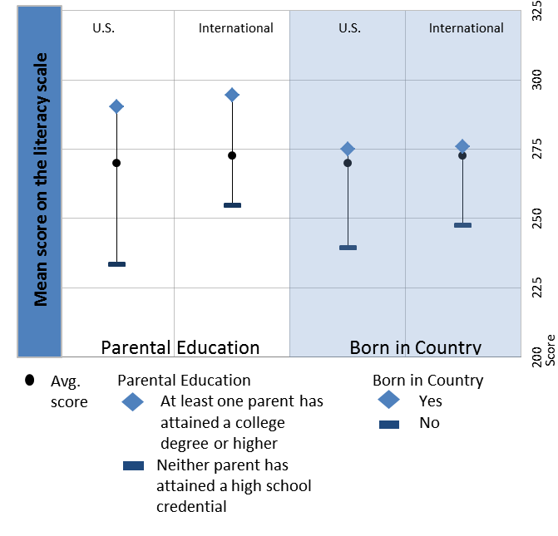
U.S. gaps in literacy scores larger than international average by parental education and nativity status
Notes:
The first comparison focuses on the gap in skills by parental education.
This shows us the persistence of low skills from one generation too the next. Look how much greater the gap in the US is between those whose parents had only a high school education and those with at least one parent who had a college education.
The same is true for nativiity: the gap between the skills of foreign born and native born is much greater in the US – although not as great as the gap related to ses.

Slide 33
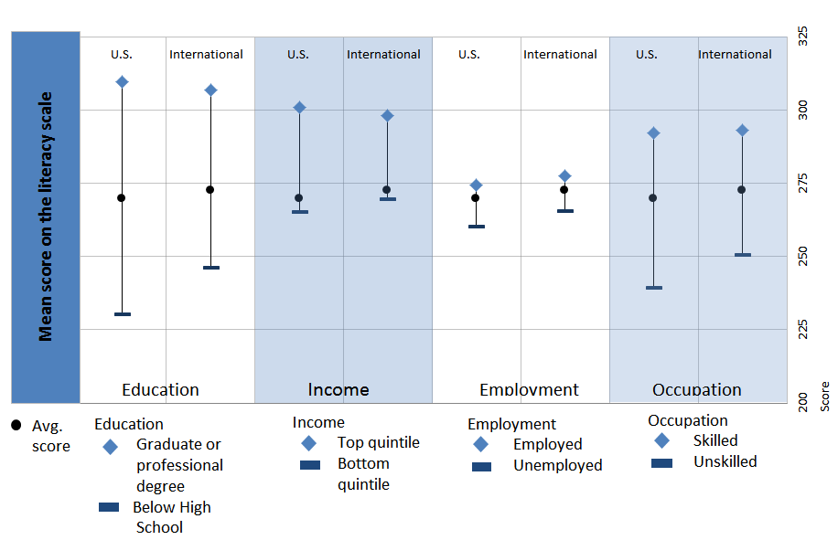
In literacy, U.S. gaps larger by educational attainment and skill level of job, but similar to international average by income and employment status
Notes:
We see a similar picture when we look at educational attainment and occupation:

Slide 34
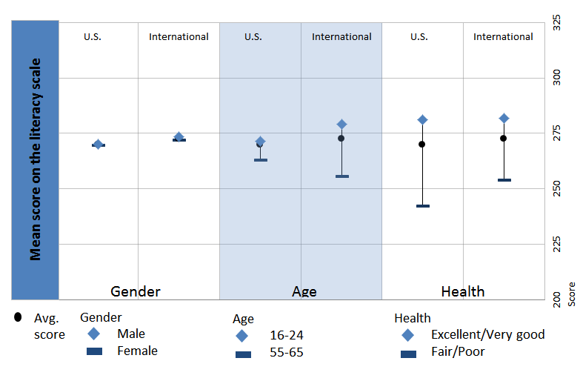
U.S. gaps in literacy scores similar to international average by gender, smaller by age, and larger by health status
Notes:
Note that the gaps are much wider in the US reported health status.

Slide 35
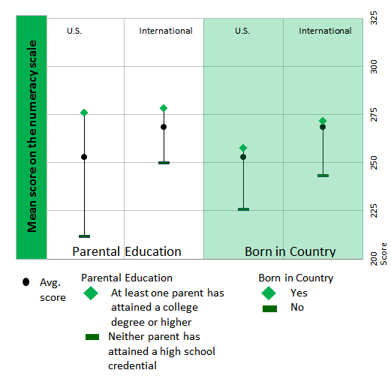
U.S. gaps in numeracy scores larger than international average by parental education, not different by nativity status
Notes:
You see the same pattern with numeracy as with literacy: in the US, the gaps are even greater by parent education and as you will see on the next slide – by educational attainment.

Slide 36
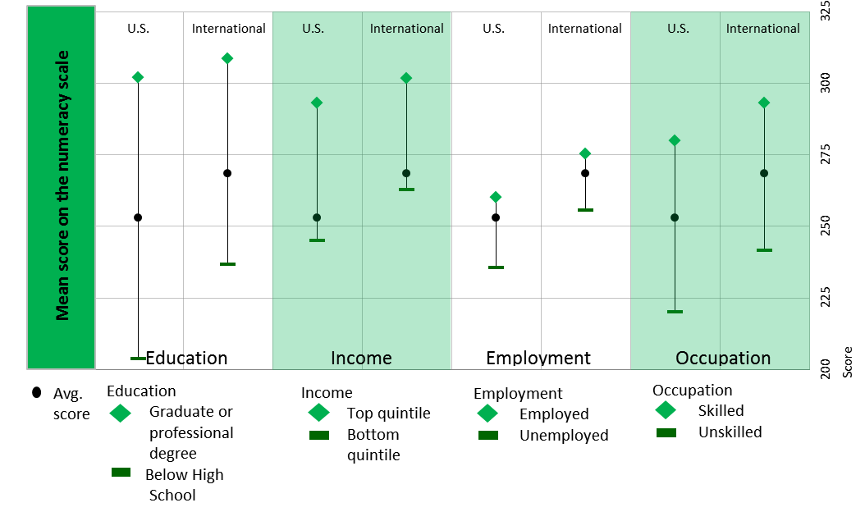
In numeracy, U.S. gaps larger by educational attainment, income, and skill level of job, but similar to international average by employment status

Slide 37
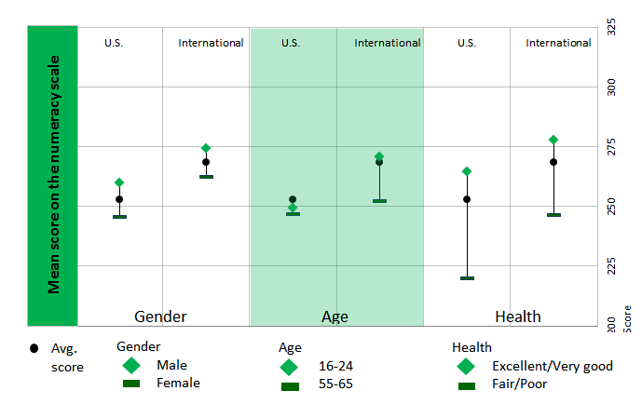
In numeracy, U.S. gap similar to international average by gender, smaller by age, and larger by health status
Notes:
What do these gaps mean? It’s the opportunity gap you here about. They suggest we are not doing a good job in reaching everyone.
That who your parents are, what educational level they have, makes a difference in what you can achieve
That while education can make a real difference, not everyone has equal access to good education in the US.

Slide 38
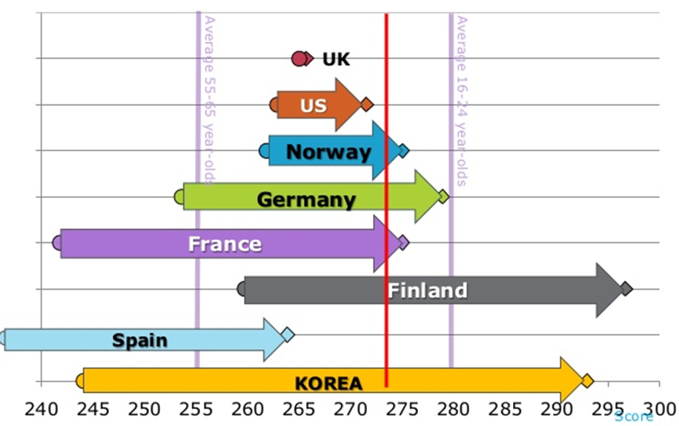
Literacy skills in younger and older generations
Notes:
Now I’d like to show you another chart that I find disturbing.
While older adults generally have lower proficiency than their younger counterparts, the extent of the gap between generations varies considerably among countries. This is likely to be related to both quality of initial education and the opportunities offered to adults to undertake further training or to engage in practices that help to maintain and develop proficiency over their lifetimes. Governments cannot change the past; however, policies designed to provide high-quality initial education and ongoing opportunities for learning can go some of the way towards ensuring that ageing adults maintain their skills.
This shows how countries have made progress in empowering the new generation in acquiring skills.
Korea’s older adults are among the lowest performing, while their youngers are among the best. This can explain how Korea has moved from an underdeveloped country to a a developed in a generation and half. Japan and Korea with no national resources
While US and UK younger generation entering labor market which is global and highly competitive with the same literacy skills of those who are leaving this market. This means they have hardly made any progress in training, education and skills. WE are just not keeping up!

Slide 39
What does the data suggest about what we need to do differently?
Do a better job of assuring every American has a strong foundation of basic skills.
Do a better job of providing skills upgrading for immigrants to America.
Do a better job of providing skills upgrading to working adults at every level so they can keep pace with change.
Understand that improving the skills of our population is everybody’s business: we can educate our way to a better economy.

Slide 40
What can we learn from key features of systems in countries that are high performers?
Notes:
So let’s look at those countries that are high performers – South Korea, Finland, Japan –
What do they do that we could do better?

Slide 41
Assure high quality initial education and high quality lifelong learning
High performers:
Invest in high quality early childhood education and initial schooling, particularly for children from disadvantaged backgrounds.
Provide financial support targeted at disadvantaged.
Provide opportunities and incentives for continued proficiency development, both in and outside the workplace.

Slide 42
Make learning everybody’s business
High Performers:
Recognize that individuals with poor skills are unlikely to engage in learning on their own and tend to receive less employer-sponsored training.
Governments join together with employers, workers and parents to make effective and equitable arrangements as to who does what, when, and how.

Slide 43
Build effective links between learning and work
High performers:
Emphasize work based learning to allow people to develop hard skills on modern equipment and soft skills through real world experience.
Employers engage in education and training with some assistance for smes.
Design learning to benefit both workplace and workers’ broader employability.

Slide 44
Identify those who can benefit most from learning
Disadvantaged adults need to be encouraged to improve learning
Foreign-language migrants
Older adults
Demonstrate to them how adults can benefit from learning, both economically and socially.

Slide 45
Improve Transparency
Make sure information about learning opportunities, financial assistance, etc. is easy to find and easy to use, even for those with low skills.
Provide good online access and good personal guidance counseling.
Recognize and certify skills proficiency.

Slide 46
Allow Workers to Adapt Learning to their Lives
Design content and delivery systems to assure maximum flexibility (part time, modular, flexible hours, convenient)
Engage distance learning and open education resources

Slide 47
How can we educate our way to a better economy and stronger democracy in the U.S.?
Use PIAAC data to advocate for more investment in adult lifelong learning.
Use PIAAC data to strengthen program approaches to building lifelong career pathways.
Use PIAAC data to create and renew local, state, and national approaches to lifelong learning where learning is everybody’s business.
Use PIAAC data and tools to document successes.

Slide 48
PIAAC Data Tools
  The PIAAC Web Portal (online tables of detailed PIAAC data) is now live on the NCES PIAAC website!
  OECD PIAAC Data Explorer available at PIAACGateway.com
Coming soon:
  U.S. PIAAC Data Explorer
  U.S. PIAAC public-use data file
  U.S. PIAAC restricted-use file
  U.S. PIAAC Technical Report
  Education & Skills Online

Slide 49
Education & Skills Online
Developed through a joint initiative of the OECD and the European Union
An assessment tool designed to provide individual level results linked to PIAAC
Measures both cognitive and non-cognitive skills
Can be downloaded on demand over the internet and includes technical support
Available in multiple languages/versions
In the US it is available both in English and Spanish
Notes:
In 11 languages, including
English - US
English - Canada
English – UK
English - Ireland
Spanish - US
Spanish - Spain
French - Canada
French - France
Italian
Czech
Japanese

Slide 50
Education & Skills Online Components
Background Questionnaire
Cognitive Items:
  Literacy
  Numeracy
  Problem-solving in Technology rich environment (optional)
  Reading Components (optional)
Optional Non-Cognitive Module
Reporting Scores:
  Proficiency levels
  Descriptive reports of strengths and weaknesses in the skill areas assessed
  Summary information for each of the non-cognitive areas
  Comparative information for both the cognitive and non-cognitive areas
Notes:
Background Questionnaire: a core set of background questions that includes: age, gender, highest level of education, country of birth and, if applicable, native language, labor force status and occupation.
Education and Skills Online Components
Behavioral characteristics related to academic and workforce readiness
Health and Subjective Well-Being
Career Interest and Intentionality
Work / Training History
Skill Use
Reporting Scores

Slide 51
Uses and Benefits of Education & Skills Online
Appropriate for use in both educational and workplace settings
Can be used to evaluate classes, programs or any group of respondents
Organizations will have access to their database for further analyses
Individuals and organizations have flexibility to determine which skills to assess
Link to trial version on PIAAC Gateway www.piaacgateway.com

Slide 52
For more information
http://nces.ed.gov/surveys/piaac/
‎ http://piaacgateway.com

Slide 53
Below level 1 literacy item
Election results
Stimulus consists of a short report of the results of a union election containing several brief paragraphs and a simple table identifying the three candidates in the election and the number of votes they received.
The test-taker is asked to identify which candidate received the fewest votes.
He or she needs to compare the number of votes that the three candidates received and identify the name of the candidate who received the fewest votes.
The word “votes” appears in both the question and in the table and nowhere else in the text.

Slide 54
Level 1 literacy item
Generic medicine
Stimulus is a short newspaper article entitled “Generic medicines: Not for the Swiss.” It has two paragraphs and a table in the middle displaying the market share of generic medicines in 14 European countries and the U.S.
The test-taker is asked to determine the number of countries with a market share greater than 10%.
The percentages are sorted in descending order to facilitate the search.
The phrase “drug sales”, however, does not appear in the text; therefore, the test-taker needs to understand that “market share” is a synonym of “drug sales” in order to answer the question.

Slide 55
Level 2 literacy item
Lakeside Fun Run
Stimulus is a simulated website containing information about an annual fun run/walk.
The test-taker is directed to a page with several links, including “Contact Us” and “FAQs”.
Then asked to identify the link providing the phone number of the organizers of the event.
In order to answer this item correctly, the test-taker needs to click on the link “Contact Us”. This requires navigating through a digital text and some understanding of web conventions.
While this task might be fairly simple for test‑takers familiar with web-based texts, some respondents less familiar with web-based texts would need to make some inferences to identify the correct link.

Slide 56
Social outcomes: health, civic participation, trust in government or others
Adults with weaker literacy skills are less likely to:
  Feel trust in others
  Believe that people like themselves have a say in what the government does
  Engage in the volunteer activities that sustain a rich civil society
On average across countries, adults who score at or below Level 1 on the literacy scale have over two times the odds of reporting “fair” to “poor” health than those who score at Level 4 or 5

Slide 57
Who are the low skilled adults in the U.S. in literacy?
Employment status
 | U.S. Pop. 16-65 = approx. 200 million |  |  | Percent of subpopulation
 |  |  | Percent of population | Below Level 1 | Level 1 | Level 2
All U.S. 16-65 |  |  | 100 | 4 | 14 | 33
Employment status
 | Employed full-time |  | 52 | 4 | 12 | 31
 | Employed part-time |  | 12 | 4 | 15 | 36
 | Unemployed |  | 8 | 5 | 24 | 41
 | In school |  | 10 | 2 | 10 | 35
 | Retired |  | 4 | 3 | 16 | 36
 | Permanently disabled |  | 5 | 14 | 29 | 40
 | Looking after family |  | 6 | 3 | 14 | 38
 | Other |  | 3 | 5 | 12 | 35
Estimates for labor force categories not shown do not meet reporting standards.

Slide 58
Who are the low skilled adults in the U.S. in literacy?
Gender and age
 |  |  |  | Percent of subpopulation
 |  |  | Percent of population | Below Level 1 | Level 1 | Level 2
All U.S. 16-65 |  |  | 100 | 4 | 14 | 33
Gender
 | Men |  | 49 | 4 | 14 | 31
 | Women |  | 51 | 4 | 13 | 34
Age
 | 16-24 |  | 18 | 2 | 12 | 37
 | 25-34 |  | 20 | 4 | 12 | 30
 | 35-44 |  | 20 | 3 | 14 | 31
 | 45-54 |  | 22 | 6 | 14 | 32
 | 55-65 |  | 19 | 5 | 16 | 34

Slide 59
Who are the low skilled adults in the U.S. in literacy?
Educational attainment
 |  |  |  | Percent of subpopulation
 |  |  | Percent of population | Below Level 1 | Level 1 | Level 2
All U.S. 16-65 |  |  | 100 | 4 | 14 | 33
Educational attainment
 | Grad/professional degree |  | 10 | # | 2 | 15
 | Bachelor’s degree |  | 16 | 1 | 4 | 22
 | Associate’s degree |  | 9 | 1 | 6 | 34
 | High school credential |  | 50 | 3 | 17 | 41
 | Below high school |  | 15 | 15 | 31 | 37

Slide 60
Who are the low-skilled adults in the U.S. in literacy?
Occupation
 |  |  |  |  | Percent of subpopulation
 |  |  |  | Percent of population |  | Below Level 1 | Level 1 | Level 2
All U.S. 16-65 |  |  |  | 100 |  | 4 | 14 | 33
Occupation classification
 | Legislators, officials, and managers |  |  | 10 |  | 1 | 6 | 22
 | Professionals |  |  | 21 |  | * | 3 | 20
 | Technicians and associates |  |  | 16 |  | 2 | 8 | 32
 | Clerks |  |  | 8 |  | 1 | 11 | 34
 | Service workers/sales |  |  | 21 |  | 5 | 17 | 37
 | Crafts and trades workers |  |  | 9 |  | 4 | 19 | 42
 | Machine operators |  |  | 6 |  | 9 | 20 | 45
 | Elementary occupations |  |  | 8 |  | 12 | 26 | 37
Estimates for occupations not shown do not meet reporting standards.
Notes:
*The item response rate is below 85 percent. Missing data have not been explicitly accounted for.

Slide 61
Who are the low-skilled adults in the U.S. in literacy?
Industry
 |  |  |  |  | Percent of subpopulation
 |  |  |  | Percent of population | Below Level 1 | Level 1 | Level 2
All U.S. 16-65 |  |  |  | 100 | 4 | 14 | 33
Industry classification
 | Manufacturing |  |  | 11 | 4 | 13 | 35
 | Construction |  |  | 7 | 5 | 22 | 41
 | Retail trade |  |  | 12 | 4 | 14 | 39
 | Transportation |  |  | 4 | 7 | 22 | 35
 | Accommodation and food service |  |  | 7 | 9 | 21 | 33
 | Information and communication |  |  | 4 | * | 3 | 19
 | Financial services |  |  | 5 | 1 | 9 | 22
 | Professional and scientific |  |  | 5 | 1 | 2 | 19
 | Administrative |  |  | 6 | 8 | 17 | 43
 | Public administration |  |  | 7 | 1 | 8 | 25
 | Education |  |  | 9 | 1 | 4 | 23
 | Health |  |  | 14 | 4 | 12 | 34
 | Arts and entertainment |  |  | 2 | 2 | 12 | 28
 | Other |  |  | 3 | 3 | 9 | 34
Estimates for industries not shown do not meet reporting standards.
Notes:
*The item response rate is below 85 percent. Missing data have not been explicitly accounted for.

Slide 62
Who are the low-skilled adults in the U.S. in literacy?
Language, immigration status
 |  |  |  | Percent of subpopulation
 |  |  | Percent of population | Below Level 1 | Level 1 | Level 2
All U.S. 16-65 |  |  | 100 | 4 | 14 | 33
Language
 | English as first language |  | 85 | 2 | 12 | 34
 | Other as first language |  | 15 | 15 | 24 | 33
Immigration Status
 | Born in U.S. |  | 85 | 2 | 12 | 34
 | Not born in U.S. |  | 15 | 15 | 25 | 31

Slide 63
Who are the low-skilled adults in the U.S. in literacy?
Race/ethnicity
 |  |  |  | Percent of subpopulation
 |  |  | Percent of population | Below Level 1 | Level 1 | Level 2
All U.S. 16-65 |  |  | 100 | 4 | 14 | 33
Race/ethnicity
 | White, non-Hispanic |  | 65 | 1 | 8 | 32
 | Black, non-Hispanic |  | 13 | 6 | 28 | 41
 | Hispanic |  | 14 | 16 | 26 | 38
 | Other |  | 8 | 2 | 13 | 39

Slide 64
Who are the low-skilled adults in the U.S. in literacy?
Employment status
Notes:
Full population self-reported laborforce status variable
Among 52% of full time employed, 4% are BL1, 12% at L1, and 31% at level 2
Among 12% of part-time employed, 4% are BL1, 15% at L1, and 36% at level 2
Among 8% of unemployed, 5% are BL1, 24% at L2, and 41% at L2
Among 10% of adults in school, 2% are BL1, 10% at L2, and 35% at L2
Among 4% retired adults, 3% are BL1, 16% at L1, and 36% at L2
Among 5% of permanently disabled, 14% are BL1, 29% at L1, and 40% at L2
Among 6% those looking after family, 3% are BL1, 14% at L1, 38% at L2
Among 3% other, 5% are BL1, 12% at L1, 35% at L2

Slide 65
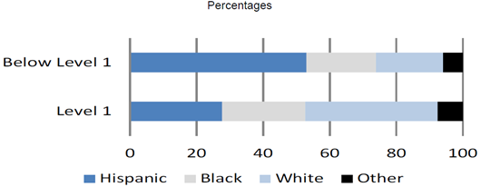
U.S. OECD Country Note
More than half of low-skilled adult population in the U.S. are black or Hispanic
Percentage of blacks and Hispanics who scored at the lowest literacy level are triple that of whites
Race/ethnicity of adults with low literacy skills in the U.S.
Source: Survey of Adult Skills (PIAAC) (2012) U.S. national dataset
Notes:
Notes:
First bullet refers to both lowest levels
Second bullet refers to Below Level 1

Slide 66
NOTE: The following slides were created by David J. Rosen, not by AIR

Slide 67
AIR PIAAC Infographics
http://bit.ly/1jY26ZD http://static.squarespace.com/static/51bb74b8e4b0139570ddf020/t/52ebc28ce4b0e18798dfdd98/1391182476687/AIR_PIAAC_Infographic_1.pdf
How would you use these with adult learners, colleagues, members of the community employers, policy makers?

Slide 68
What are the implications of these results for our society?
Economic competitiveness
Democracy
Cost of poor health to society
Deeper inequities and further polarization of haves and have-nots

Slide 69
1.What is/could be the significance of these results for:
Members of your community
Employers
Colleagues
Learners – actual or potential

Slide 70
2. Would you consider using the online survey?
With teachers? Why or why not?
With adult learners? Why or why not?

Slide 71
3. What implications do the data have for what you teach?
For example, Problem Solving in Technology-Rich Environments?
How are you teaching this now?

Slide 72
4. How could you/your program use the data for advocacy?

Slide 73
Evaluation
What is the most important takeaway for you?
What are your next steps?
  Take the online assessment?
  Presemt some of the slides to your colleagues?
  Raise awareness of PIAAC results in your community?
  Other?

