Slide 1

How to Skip Developmental Courses
NETWORK
April 4, 2014
Notes:
Welcome
Derek Kalchbrenner
Gary Kaplan couldn’t be here.

Slide 2
What is JFYNetWorks?
JFYNetWorks is a Boston-based non-profit provider of blended learning programs to high schools, community colleges and community agencies.
The JFYNet program is a school-based blended learning program that brings online resources into the classroom and helps teachers use them effectively to raise student achievement, reduce achievement gaps and help students reach college readiness.
The Standards Plus library of online resources covers all state, Common Core, and college standards.
JFYNet provides instruction to more than 5,000 students per year.
2
Notes:
Our programs are conducted in schools, community agencies, and community colleges.

Slide 3

Dr. Dana West, Principal
“
Most companies sell you a product and run. JFY stays with you and helps your staff get the most out of the program that your students are capable of. The communication and follow up are excellent. They’re really helping us send our graduates to college able to compete.

Slide 4
What is the ACCUPLACER?
ACCUPLACER is a suite of computer-adaptive diagnostic and placement tests that assess reading, writing, and math skills.
ACCUPLACER is a College Board product.
Most commonly used assessments: Reading Comprehension, Sentence Skills, Arithmetic, Elementary Algebra, and WritePlacer (essay).
4
Notes:
Description
Features.
My agency is an Accuplacer site. We use the diagnostics for intervention.
Accuplacer isn’t a pass/fail test. Individual schools set what are called cut points for placement purposes.

Slide 5
Placements vs. Diagnostics
ACCUPLACER Placements
  Untimed and adaptive
  12 – 20 items
  Provide numerical scores
ACCUPLACER Diagnostics
  Untimed and adaptive
  40 items, 5 domains per test, 3 skill levels per domain
  Domain level numerical scores, categorical scores and proficiency statements
  Individual, summary and score roster reports provide diagnostic information to guide instruction
Notes:
Similarities:
Run off the same platform
Draw items from the same data bank
Differences
Length of the test
Data provided.

Slide 6
How is the ACCUPLACER used in Massachusetts?
The Massachusetts Department of Higher Education requires each public institution to assess the academic skills of entering students in mathematics, reading, and writing.
All entering first-year students at Massachusetts public colleges and universities are required to take the ACCUPLACER Placement Tests in Reading Comprehension, Arithmetic, Elementary Algebra, and Writing*.
Students who do not meet qualifying scores must take developmental courses.
More information at: Admissions & Transfer / Information and Tools for Students / Massachusetts Department of Higher Education
6
*Schools have multiple options for the writing requirement: ACCUPLACER Sentence Skills, ACCUPLACER WritePlacer, or a school – developed test.
Notes:
All 29 Massachusetts public colleges: the Umass system, the state universities (Salem State University), and the 15 community colleges. Some private colleges use it.
Writing.

Slide 7
What are Developmental Courses?
Developmental courses are college courses that provide students with the fundamentals in math or ELA.
Developmental courses cost the same tuition and fees as regular college courses but do not count towards a degree.
Depending on ACCUPLACER scores, students can be required to take up to 7 developmental courses.
7
Notes:
Hand out Mass Community College list.

Slide 8
% First Time, Full Time Students Who Take Developmental Courses in Massachusetts
Community Colleges: 65%
State Universities: 22%
University of Massachusetts: 8%
Reasons for low ACCUPLACER Passing Rates:
Lack of correlation between ACCUPLACER and MCAS or GED
Lack of correlation between high school /ABE curricula and ACCUPLACER
Students are unfamiliar with the computer adaptive test format
8
Notes:
Are taking a least 1 developmental course
BHCC 98% percent of their incoming freshmen class was taking 1 or more developmental math courses.

Slide 9
AIM for Success
Assess
Instruct
Measure

Slide 10
JFYNet ACCUPLACER Readiness
JFYNet uses College Board’s ACCUPLACER Diagnostics to identify student needs and assign targeted instruction and evaluation
  Assess. JFY administers ACCUPLACER Diagnostics.
  Instruct. JFY’s ACCUPLACER curriculum targets instruction based on students’ diagnostic reports.
  Measure. JFY administers interim assessments and final Accuplacer Placements to measure progress.
  Manage. Onsite and online teacher training and support.
Notes:
Now, our Accuplacer Readiness Program
Broadly it has 3 components, the first of which is assessment.
We start students with the diagnostics because they provide more data.

Slide 11
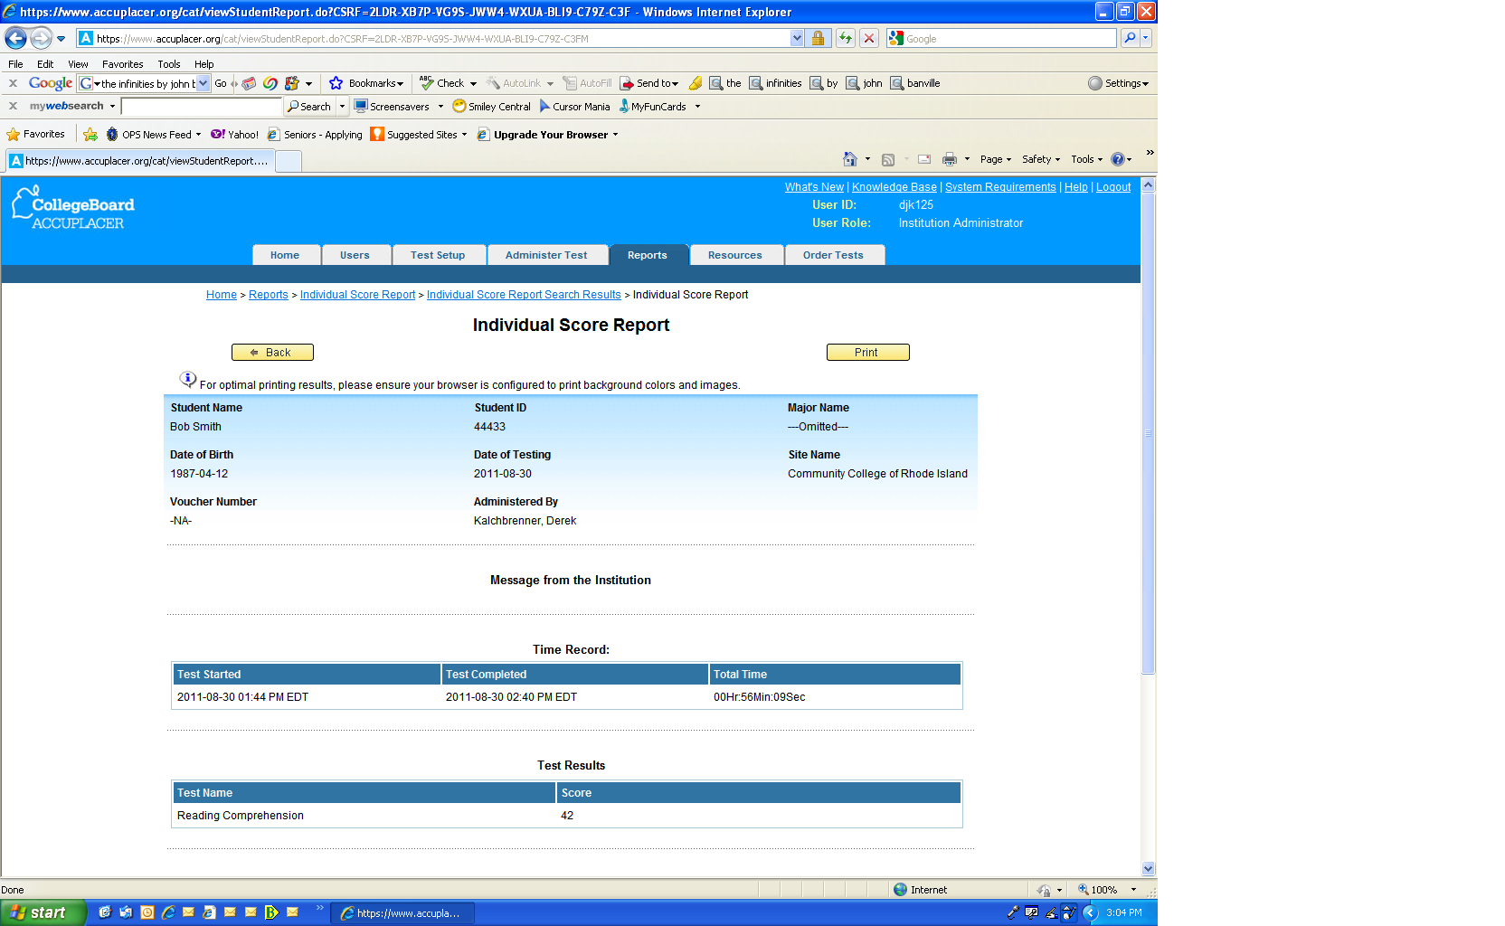
ACCUPLACER Placement
Report
Notes:
This only provides 1 data point.
If you remember, the score range is 0 – 120.
68 is a passing score at most schools.
This student is looking at having to take at least 1, but more likely 2 developmental reading courses.

Slide 12
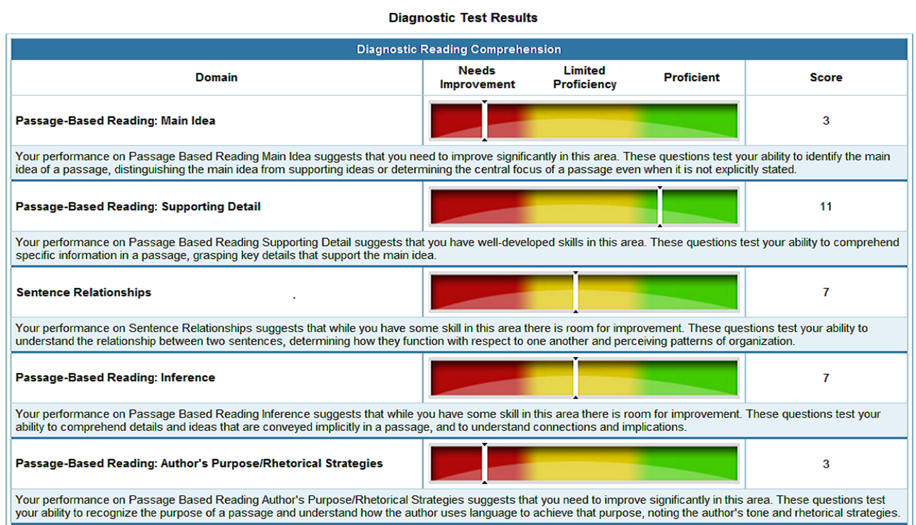
ACCUPLACER Diagnostic Report
Notes:
Provides scores in 2 ways:
5 Domains. This is a Reading Comprehension report
Category score
Numerical score. 15 for each domain. 0 – 4 is red, 5 – 9 is yellow, 10 and above is proficient.
You went from having 1 data point to having 10.
Proficiency statements

Slide 13
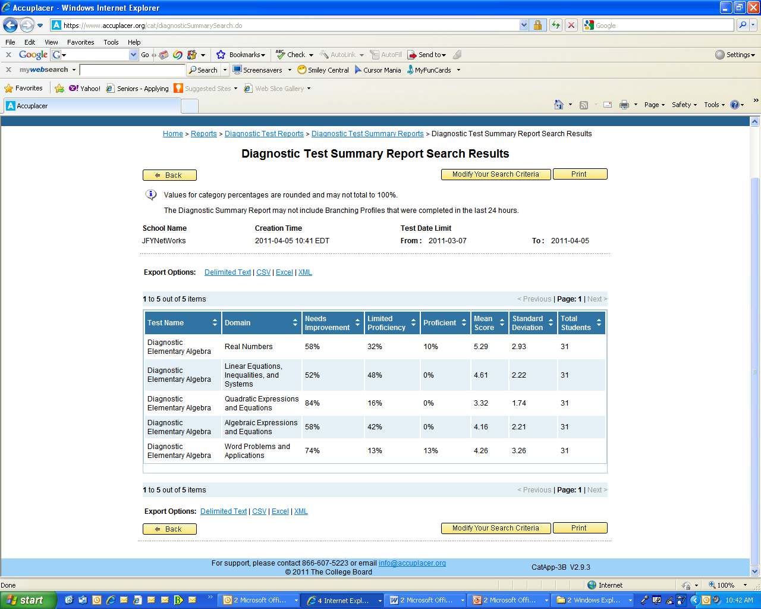
ACCUPLACER Diagnostic Test Summary Report

Slide 14
JFY class and individual student report
14
Notes:
We then take these individual reports, aggregate the results, and provide some additional reports.
This one shows a class of students’ individual and group results by subject and domain. The individual results are in the table at the top; the bar chart below shows their collective performance as a class.
This can help instructors make targeted interventions on both an individual and class level. This bar chart shows this class needs the most work on Domain 3, Quadratic Expressions.
But they also need a lot of work in Domains 4 & 5 and in 1 & 2 for that matter. But you can see at a glance how things stack up.

Slide 15
JFYNet
Progress through developmental levels
Notes:
Another reason for using the diagnostics and so we can track progress according to a school’s cut scores.
Red quadrant got smaller, but the orange and yellow quadrants got larger.
Eliminate some courses still helps.

Slide 16
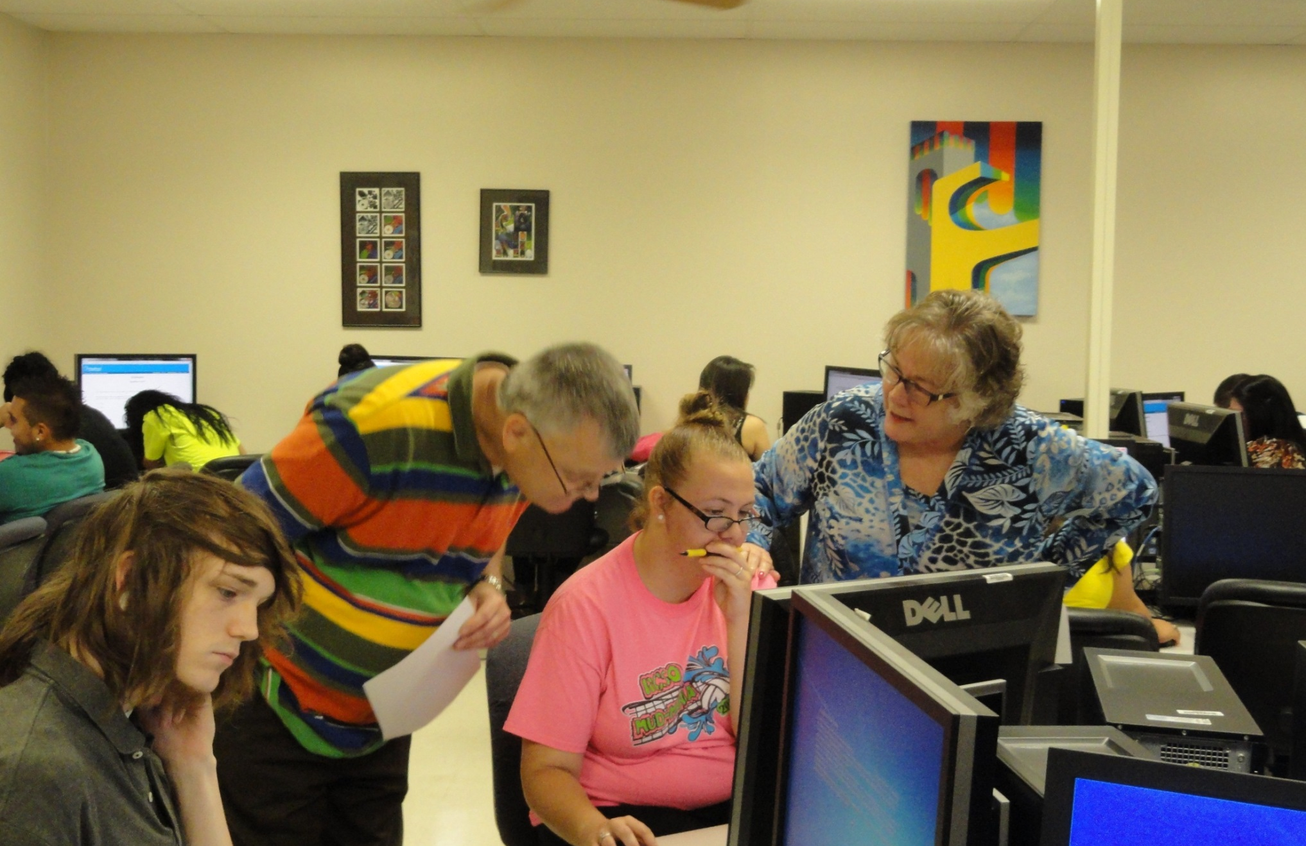

Slide 17
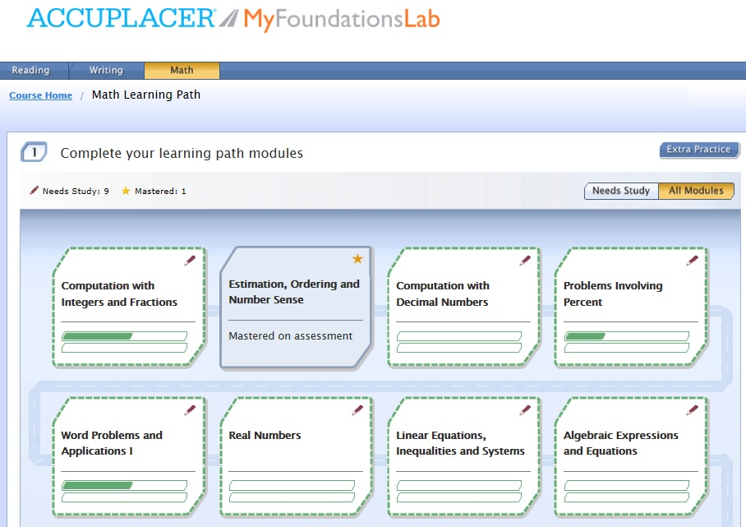
Instructional products:
Pearson
Notes:
Once students finish the diagnostics, we create individual instructional programs for them. We use several different products for this.
Here is part of a math curriculum in Pearson’s MyFoundationsLab.
With each of the products we use, we create alignments based on the test we’re preparing students for such as MCAS and Accuplacer.
The Domains that are shown here match what’s in ACCUPLACER.

Slide 18
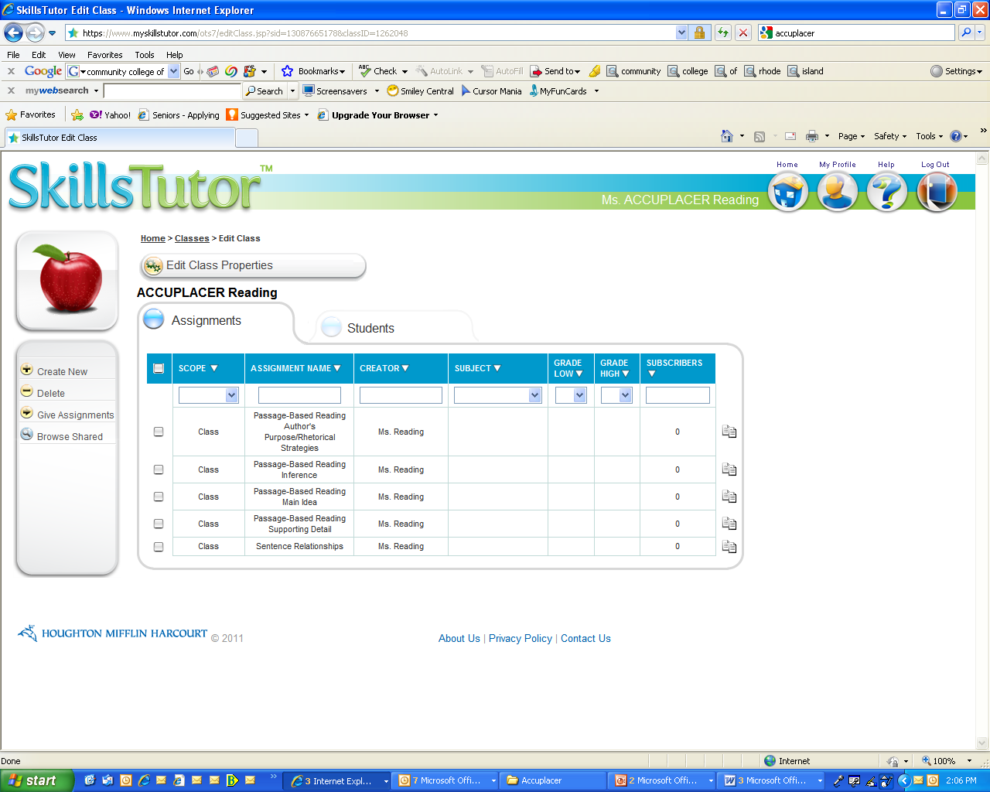
Instructional products : Skills Tutor
JFY’s Learning Management System aligned to ACCUPLACER Diagnostics
    Skills Tutor assignments correspond to 5 ACCUPLACER Diagnostic Domains
Notes:
Here’s an example of a student program in Skills Tutor.
Same structure, broken into domains, aligned to the Accuplacer.

Slide 19
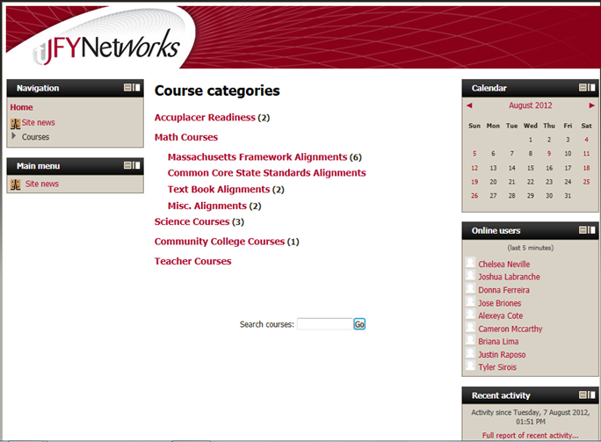
Instructional products: JFY Moodle
JFYNet’s Learning Management System
Notes:
Pearson and Skills Tutor are only 2 of our resources. We also have an extensive curriculum bank on our moodle page, consisting of selected online resources we have compiled over the several years.

Slide 20
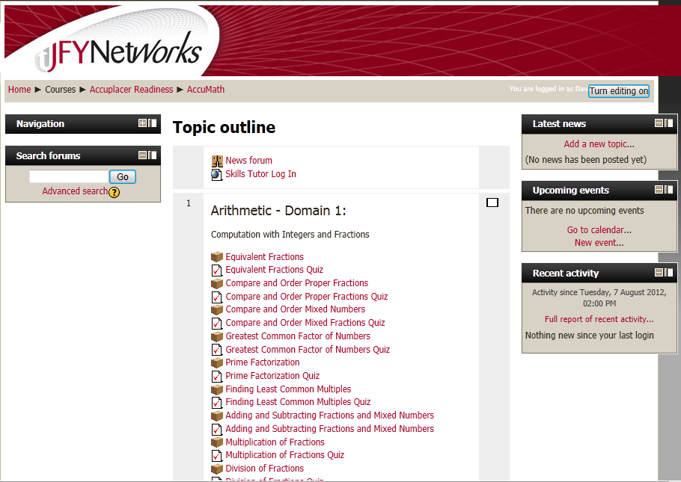
Arithmetic Course: Domain 1
Notes:
Here’s a section of our Accuplacer Arithmetic alignment.

Slide 21
Onsite Support
Every JFYNet site is assigned a Blended Learning Specialist who …
  Administers all ACCUPLACER assessments
  Creates all classes online
  Trains staff and orients students to the program.
  Provides ongoing support and professional development
  Provides oversight of the online management system, analyzing data, generating reports, and making curriculum adjustments.
  Provides support and answers questions onsite and via phone/email/webex.
Notes:
Now, how do we mange all this.

Slide 22
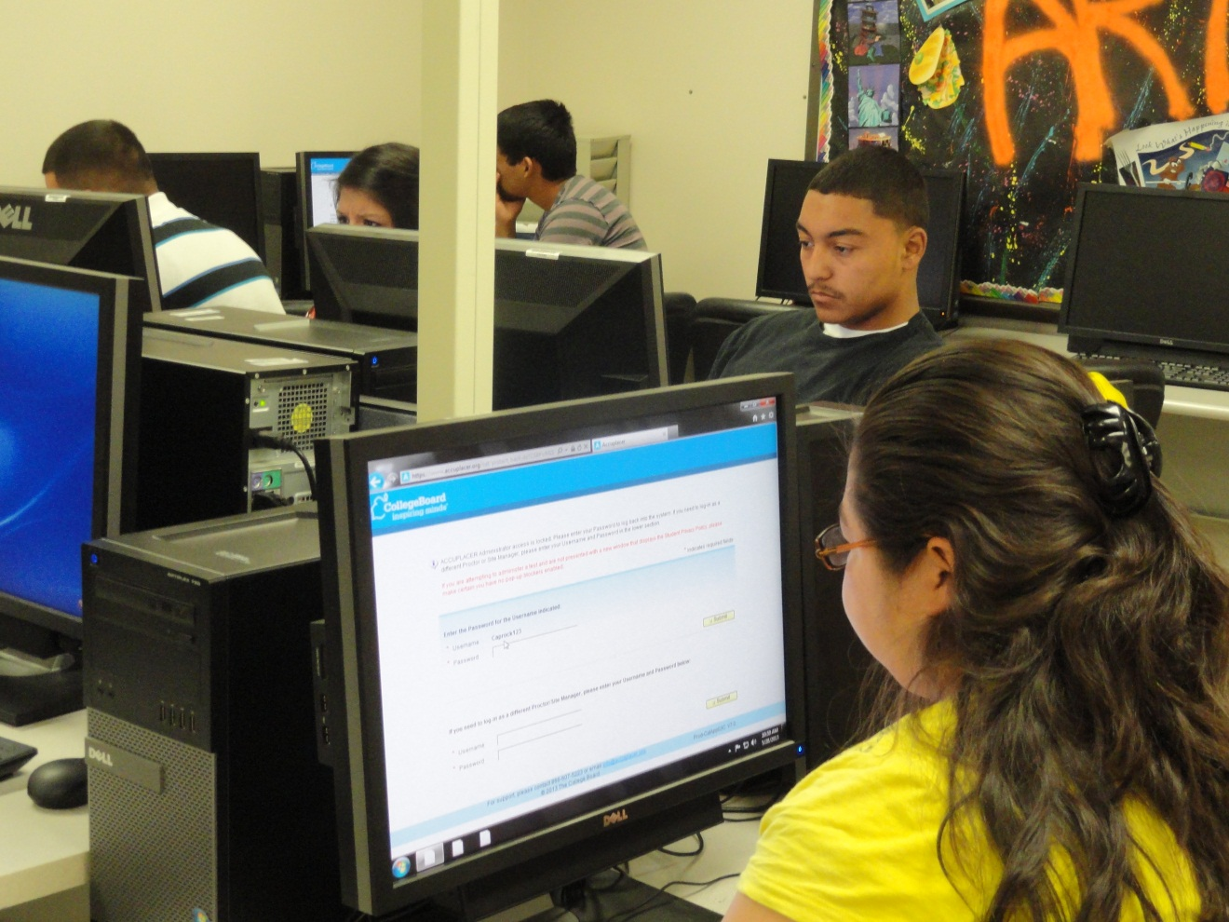
“
The software is good because I can listen to it and read it at the same time. I felt all the way through that I was getting it. I was making 90s and 100s on the quizzes. That gave me confidence. I felt like I knew what I was doing on the final.”

Slide 23
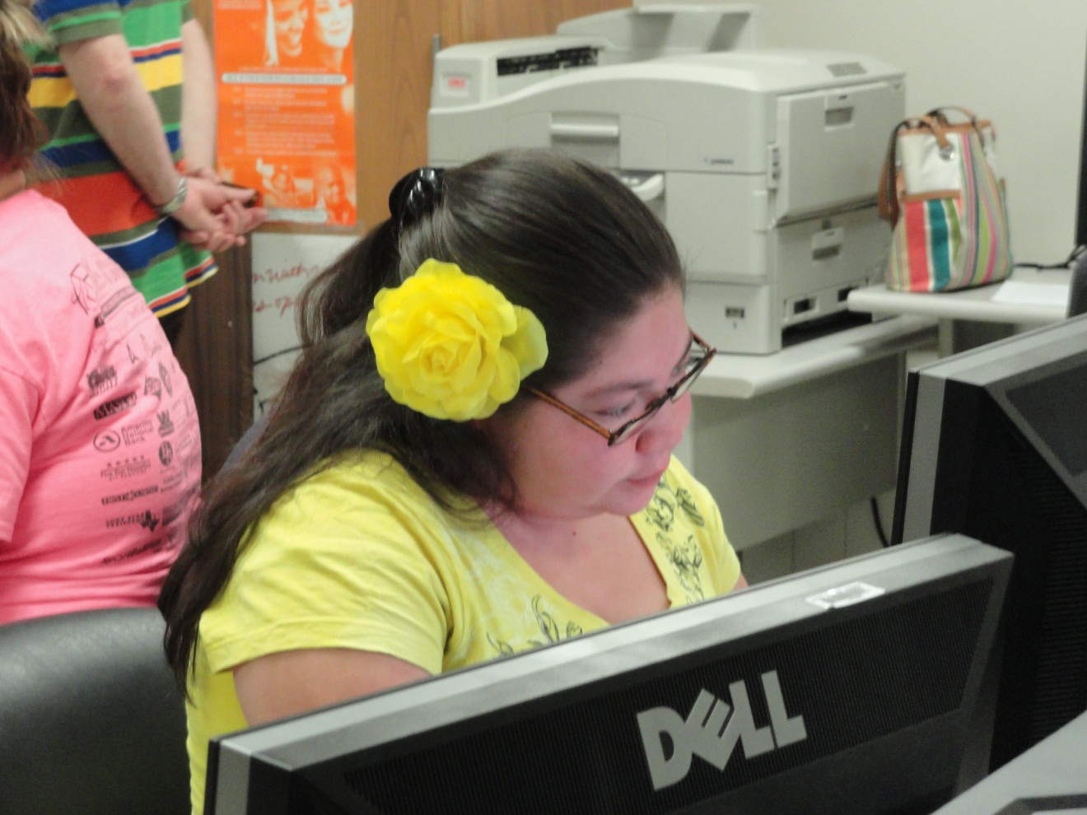
“
I’m going to community college to get my basics done and then I want to go to law school. I have the motivation and determination to win cases. A lot of people put me down and tell me I can’t do it. I want to prove them wrong.

Slide 24

JFYNet Accuplacer Prep
1,158 Courses Eliminated
$634,460 Saved
Pre-JFY DevEd
Classes
1,158
Classes
Eliminated
Post-JFY Developmental
Classes Needed
Updated 3/2014

Slide 25
Brighton High School
ACCUPLACER Readiness Program Summary
SY 2012 - 2013
Accuplacer Prep
Brighton High School Boot Camp
May-June 2013
Subject | # of students pre- tested | Initial # of remedial Classes needed (all students) | # of students instruc- ted¹ | # of students post-tested¹ | Initial # of remedial Classes needed² (active students) | Final # of remedial Classes needed² (active students) | # of students improved² | % of students improved² | Average points improved² | Remedial Classes elimin- ated² | % of remedial Classes elimin- ated² | Tuition saved³
Arithmetic | 169 | 73 | 108 | 142 | 58 | 22 | 103 | 73% | 25 | 36 | 62% | $20,304
Elem.Alg | 145 | 212 |  | 173 | 187 | 96 | 125 | 72% | 29 | 91 | 49% | $51,324
Reading | 61 | 73 | 32 | 38 | 31 | 16 | 21 | 55% | 23 | 15 | 48% | $8,460
Total tests | 375 | 358 | 140 | 353 | 276 | 134 | 249 | 71% | 27 | 142 | 51% | $80,088
Total # students | 198 |  | 202 | 192
(unduplicated)
¹ Not all students followed through with instruction or post tests
² Post-tested students only
³ Bunker Hill Community College Course Cost: $564

Slide 26
JFYNet Accuplacer Prep
Cambridge Rindge & Latin School
Accuplacer Boot Camp
June, 2013
Subject | # of students pre- tested | Initial # of remedial Classes needed (all students) | # of students instruc- ted¹ | # of students post-tested¹ | Initial # of remedial Classes needed² (active students) | Final # of remedial Classes needed² (active students) | # number of students improved² | % of students improved² | Average points improved² | Remedial Classes elimin- ated² | % of remedial Classes elimin- ated² | Tuition saved²
Reading | 17 | 22 | 9 | 15 | 19 | 6 | 12 | 80% | 20 | 11 | 68% | $6,050
Writing | 6 | 3 | 4 | 16 | 1 | 0 | 14 | 88% | 26 | 1 | 100% | $550
Arithmetic | 21 | 10 | 23 | 12 | 5 | 0 | 11 | 92% | 21 | 5 | 100% | $2,750
Elem.Alg | 21 | 24 | 23 | 19 | 19 | 5 | 19 | 100% | 27 | 14 | 74% | $7,700
Total Tests | 65 | 59 | 59 | 62 | 44 | 11 | 56 | 90% | 24 | 31 | 70% | $17,050

Slide 27
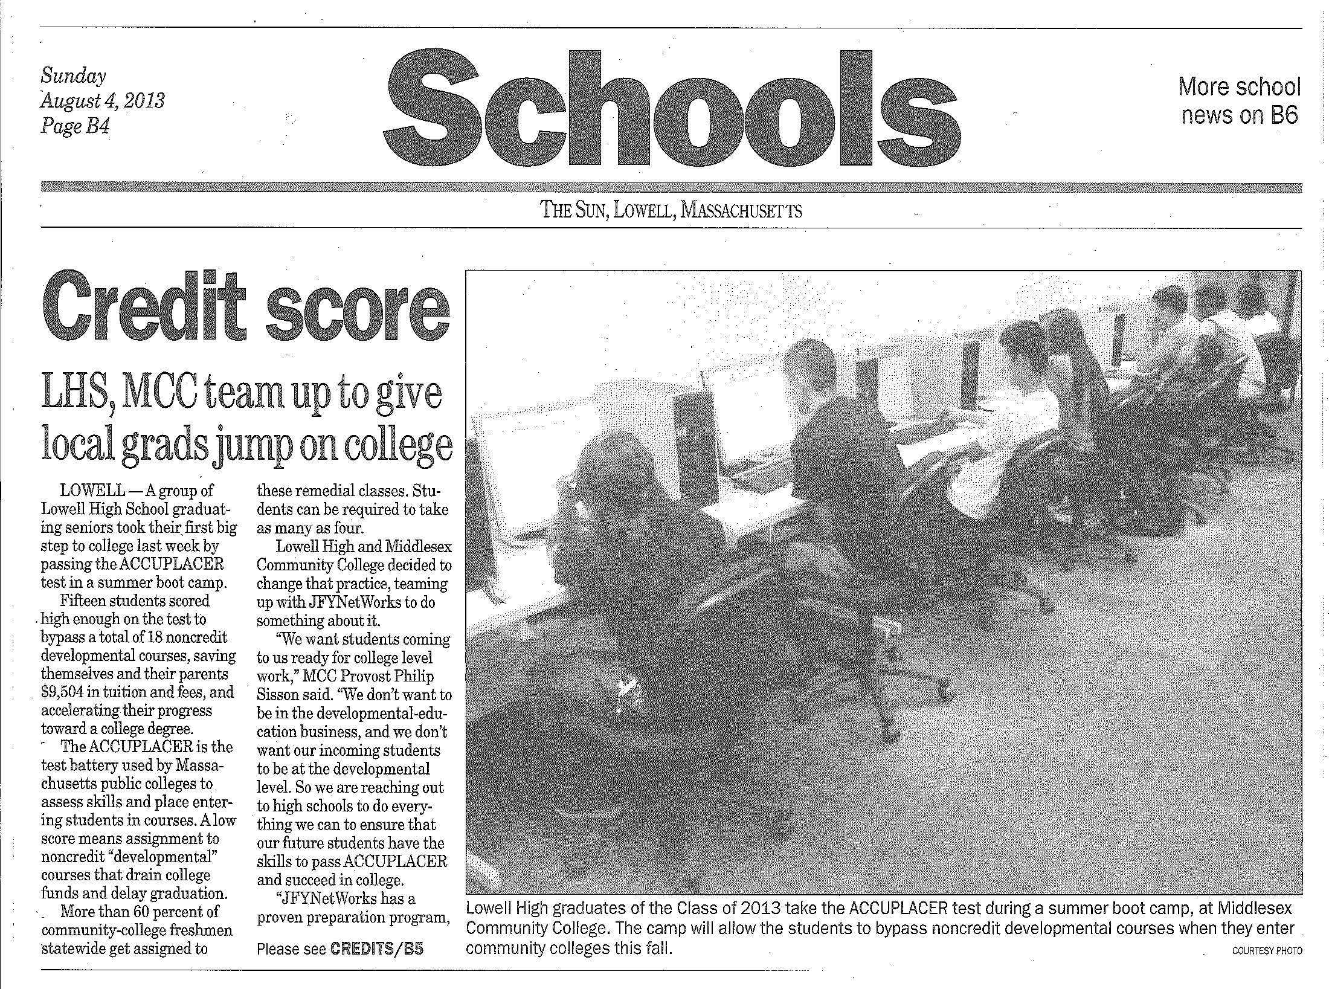
Credit Score
LHS, MCC team up to give local grads jump on college

Slide 28
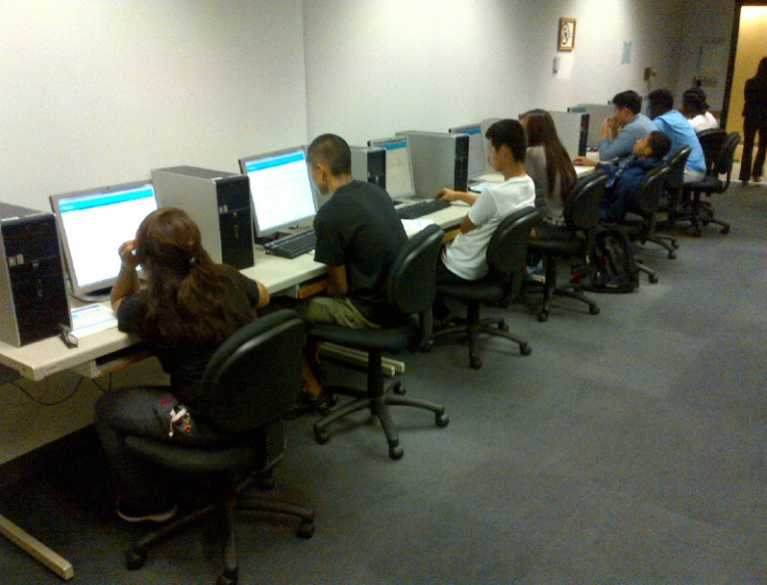
JFYNet Pathways to College at Lowell High School Summer Boot Camp 2013 continued
# students pre-tested | Initial # remedial classes needed (all students) | # students instructed¹ | # students post-tested¹ | Initial # remedial classes needed² (active students) | Final # remedial classes needed² (active students) | # students improved² | % students improved² | Avg points improved² | Remedial classes eliminated² | % remedial classes eliminated² | Tuition saved³
36 | 61 | 35 | 32 | 56 | 38 | 25 | 78% | 14 | 18 | 32% | $9,504
¹Not all students followed-through with instruction or post-tests ²Post-tested students only ³MCC course cost $528
One teacher commented:
“Every student who participated in the “Accuplacer Readiness Program” showed improvement and authentic achievement. The self-paced, individualized tutorials assured that every student could succeed. Their success was manifold: not just a passing grade or credit toward a high school diploma, but the elimination of remedial courses at the college level. One girl, who seemed to lag behind in the tutorials, ended up eliminating three remedial classes at the local community college! I wish every course that I teach could have the remarkable “real-world” outcomes of the “Accuplacer Readiness Program.”
Katie L. Dube, M.Ed.
Lowell High School”

Slide 29
JFYNet Accuplacer Prep
Essex Agricultural & Technical High School
2011-2012
Subject | # students pre- tested | Initial # remedial Classes needed (all students) | # students instruc- ted¹ | # students post-tested¹ | Initial # remedial Classes needed² (active students) | Final # remedial Classes needed² (active students) | # students improved² | % students improved² | Average points improved² | Remedial Classes elimin- ated² | Tuition saved²
Arithmetic | 29 | 42 | 48 | 27 | 38 | 22 | 19 | 70% | 22 | 16 | $8,800
Elem. Alg | 19 | 22 |  | 17 | 20 | 12 | 14 | 82% | 15 | 8 | $4,400
Reading | 43 | 80 | 42 | 37 | 69 | 40 | 19 | 51% | 21 | 29 | $15,950
Totals | 91 | 144 | 90 | 81 | 127 | 74 | 52 | 64% | 20 | 53 | $29,150
2012-2013
Subject | # students pre- tested | # remedial Classes needed | # students instruc- ted¹ | # students post-tested¹ | Initial # remedial Classes needed² (active students) | Final # remedial Classes needed² (active students) | # students improved² | % students improved² | Average points improved² | Remedial Classes elimin- ated² | Tuition saved²
Arithmetic | 115 | 38 | 83 | 97 | 31 | 19 | 72 | 74% | 14 | 12 | $6,600
Elem. Alg | 113 | 104 |  | 79 | 56 | 30 | 66 | 84% | 20 | 26 | $14,300
Reading | 43 | 46 | 35 | 25 | 26 | 14 | 20 | 80% | 16 | 12 | $6,600
Totals | 115 | 188 | 118 | 201 | 113 | 63 | 158 | 79% | 17 | 50 | $27,500

Slide 30



Comments, Questions, Answers? Call US!
For more information contact:
Gary Kaplan, Executive Director
gkaplan@jfynet.org
Derek Kalchbrenner, Program Manager
dkalchbrenner@jfynet.org
Let’s get social
LIKE us on FaceBook: http://www.facebook.com/JFYBoston
Follow us on twitter: https://twitter.com/#!/JFYNetworks

