Slide 1
CRITICAL THINKING, DATA ANALYSIS AND SCIENCE
THE LIFE SCIENCE STRAND OF THE
NEW SCIENCE FRAMEWORK
Michele Bahr, Aliza Ansell, Lenore Balliro
          NETWORK
          April 2014

Slide 2
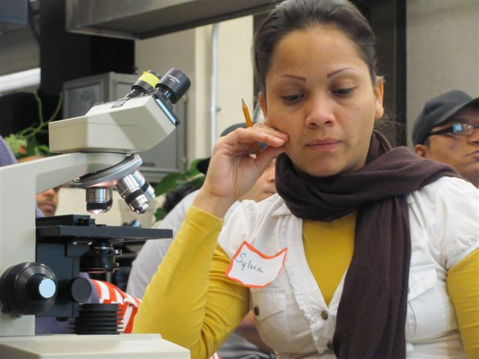
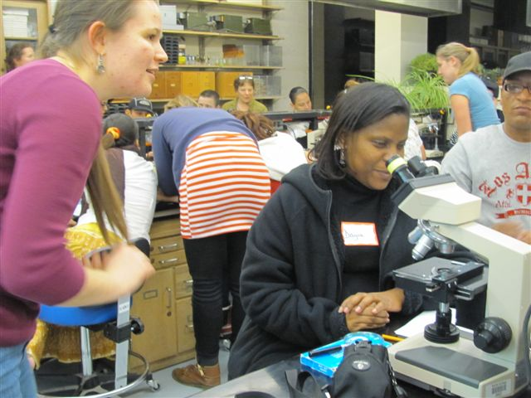
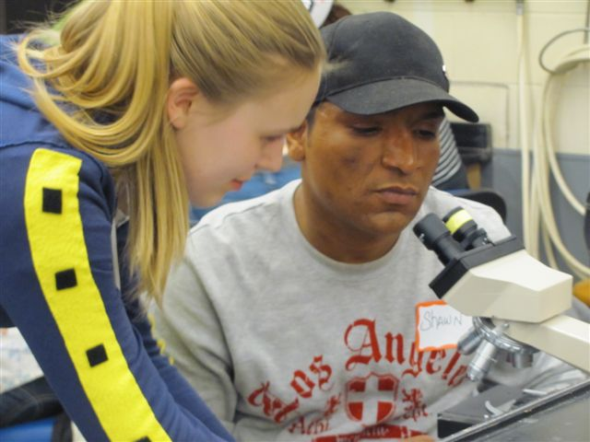
Updating Life Science
Appropriate for the ABE classroom
Practitioner-friendly
Drawn from 30 years of science education research by
the National Research Council, beginning with Science for All Americans in 1989 and culminating in the Next Generation Science Standards, 2013

Slide 3

LIFE SCIENCE STANDARD 1
CELL BIOLOGY
Questions
What is a cell?
How do cells get and use what they
need to live and grow?
How do cells divide?
What is the role of cells in
sexual reproduction?

Slide 4
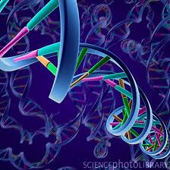

LIFE SCIENCE STANDARD 2
Genetics
Questions
How are parents and offspring alike?
How are the characteristics of one generation of organisms related to the previous generation?
Why do individuals of the same species vary in how they look and function?

Slide 5
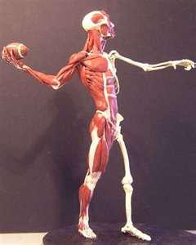
LIFE SCIENCE STANDARD 3
Anatomy and Physiology
Questions:
How are organ systems formed?
What systems make up the body of an animal?
How do the systems of a body work together?

Slide 6
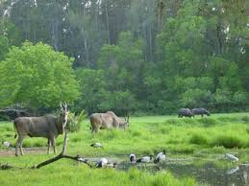
LIFE SCIENCE STANDARD 4
Ecology
Questions:
What are the components of an ecosystem?
What are the interactions between living things and the non-living parts of an ecosystem?
How do scientists use observation and experimentation to study ecosystems?

Slide 7

LIFE SCIENCE STANDARD 5
EVOLUTION and BIODIVERSITY
Questions:
How have organisms changed over time?
How does the fossil record provide evidence of
different life forms at different periods of
geological history?
What is biodiversity?

Slide 8
The LIFE SCIENCE standards can be introduced from multiple entry points
ANATOMY AND PHYSIOLOGY
CELL BIOLOGY
ECOLOGY
EVOLUTION AND BIODIVERSITY
GENETICS

Slide 9
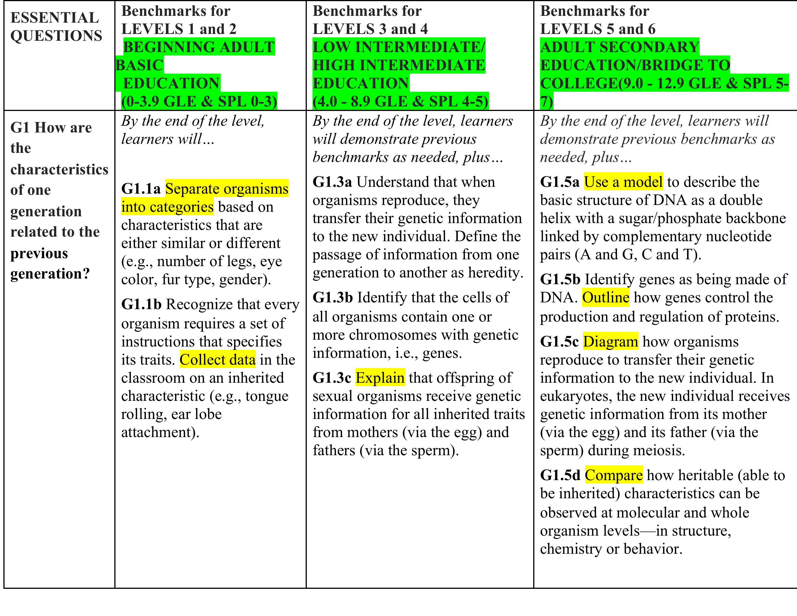
The LIFE SCIENCE standards have been designed for all levels

Slide 10
What about HiSET?
The emphasis in science on conclusions drawn from evidence aligns with the shifts in the ELA Standards;
The emphasis on representing data in different ways and in interpreting charts, graphs, and tables aligns with the Math Standards: develop conceptual understanding; procedural fluency, and application in equal measure
Science-specific vocabulary will be important;
Practice test questions focus on understanding experimental procedures and interpreting results.

Slide 11
FUTURE WORK ON THE SCIENCE FRAMEWORK
Two additional Professional development workshops will
be held in the West and Southeast regions in May
2014-2015 Develop curricula that will Integrate the Life Science Strand with the Career and College Readiness Standards for Math and Numeracy, Language Arts and ESOL classes
Ultimately, develop a complete science framework with input from practitioners
Michele Bahr 86oakwood@gmail.com

